Slide 1
Part 21 Edition 3
“Crowd sourcing massive product models”
Dr. Martin Hardwick
President STEP Tools, Inc.
Team Leader ISO STEP-Manufacturing
Professor of Computer Science, RPI

Slide 2
Crowd Sourcing Massive Product Models
Design of a complete aircraft, ship or vehicle
Manufacturing operations across a supply chain
Construction of a skyscraper
The models are massive
The models are made by thousands and used by millions

Slide 3
Available Elements
Extensible information models
STEP for design
STEP-NC for manufacturing
IFC for building and construction
Other file types – JT, XML, 3DPDF etc
CAD, CAM and BIM systems that can make data for very large fragments of the models

Slide 4
Design goals of Part 21 Edition 3
Massive Product models
Support data linking outside of a CAD system
Enable the use of URI’s and URL’s
Divide large files into multiple smaller files
Crowdsourcing
Add intelligence using JavaScript
Light weight, open-source binding
Quick and easy data manipulation
Upward and downward compatible with e2 and e1

Slide 5
Anchors and References
ISO-10303-21;
HEADER;
FILE_DESCRIPTION( ... )
FILE_NAME( ... );
FILE_SCHEMA ( ... );
ENDSEC;
ANCHOR;
<tool_tip_face> = #100;
<tool_tip_usage> = #100;
<tool_tip_unused> = $;
ENDSEC;
REFERENCE;
#1234 = <http://www.tool.com/mill#bottom_face>;
#1235 = <http://www.tool.com/mill#bottom_face_rep>;
ENDSEC;
DATA;
#100= CHAIN_BASED_GEOMETRIC_ITEM_SPECIFIC_USAGE
( . . ., #1234, (#1235,#22,#23) . . .);
ENDSEC;
END-ISO-10303-21;

Slide 6
Model Population
Model population is
All data sections in current file
All data sections in referenced files
All data sections in files listed in a schema_population
Link File
“Orphaned” without
the schema_population
Massive product model
Workpiece STEP File
Workplan
STEP-NC File

Slide 7
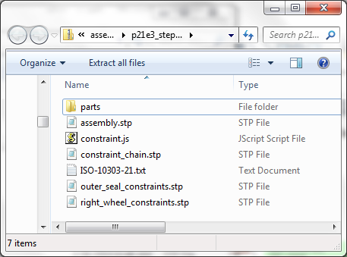
ZIP Archives
ISO-10303-21;
HEADER;
ECMASCRIPT (‘constraints.js’);
ENDSEC;
ANCHOR;
<as1_pe >= #as1_pe
REFERENCE;
#as1_pe = <assembly.stp#root>;
#bolt = <part/bolt.stp#bolt>;
#nut = <part/nut.stp#nut>;
#rod = <part/rod.stp#rod>;
#plate = <part/plate.stp#plate>;
#l-bracket = <part/l-bracket.stp#l-bracket>;
ENDSEC;
END-ISO-10303-21;
Archive
(as1.stpz)
Directory
(ISO-10303-21.txt)

Slide 8
Multi-File References
Anchor can be referenced from other file types
Reference can be to another file type
Reference format resolved by protocols and mime types
ANCHOR;
<tool_tip> = #100; /* Can be referenced from JT or XML */
ENDSEC; /* E.g. <mill#tool_tip> */
REFERENCE;
#1234 = <http://www.tool.com/holder.jt#bottom_face>;
ENDSEC;

Slide 9
JavaScript
Function to connect a workpiece to a workplan
function linker(model, workplan, workpiece, type)
{
with workpiece.anchor.$type.credentials {
if (stage != 'manufacturing')
return null;
if (status != 'released')
return null;
}
with model.reference {
if (name != 'as_is shape' && name != 'to-be shape' && name != 'removal shape') // alternate is to check using a mapping table compiler
return NULL;
if (workpiece.anchor.$tag.shape.type != 'product_definition_shape') // alternate is to check using an EXPRESS compiler
return NULL:
if (workpiece.anchor.$tag.shape.geometry != 'advanced_boundary_representation') // application constraint
return NULL;
name = type;
shape = workpiece.anchor.shape;
exec = workplan.anchor.executable; // checking this left as an exercise for the reader
workplan.schema_population.set_population ((new P21.Population).set_uri (model)); // add this link to the population of the workplan
return model;
}
}

Slide 10
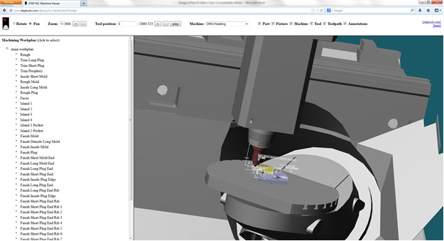
JavaScript demonstrations http://www.steptools.com/demos/

Slide 11
CAM Tooling Pilot
SaveAs STEP-NC
Make operations with generic tooling
STEP-NC File
Make tooling recommendations
Job
Shop
CAM
Tool
Vendor
CAM
E3 linking
STEP Tool 2
STEP Tool 1
STEP-NC File
15% better machining*
SaveAs STEP-NC with optimal process
*average

Slide 12
Summary
Edition 3 adds intelligent interfaces to STEP, STEP-NC and IFC
Massive shared product models
Open and closed loop manufacturing
Next steps are
Review of current draft by TC184/SC4 in Paris
http://www.steptools.com/library/standard
Verification with open source examples
Submit for ballot as DIS

Slide 13
Backup

Slide 14
Part 21 Editions 1 & 2
Very successful - edition 1 in 1994, edition 2 in 2002
Implemented by all the CAD, CAM and BIM vendors.
Upward compatible across many, many enhancements.
Very fast implementation by translation systems.
Designed for easy implementation
Minimal data format for maximal upward compatibility.
No URI’s, OIDs of other fancy features.
No concessions to easy data presentation.

Slide 15
Known Issues
The information models are supported by a file format that was designed to be written by one system in its entirety, and read by another system in its entirety.
The information models are hard to program because of all the requirements that must be met to avoid ambiguity and enable extensibility.

