Slide 1
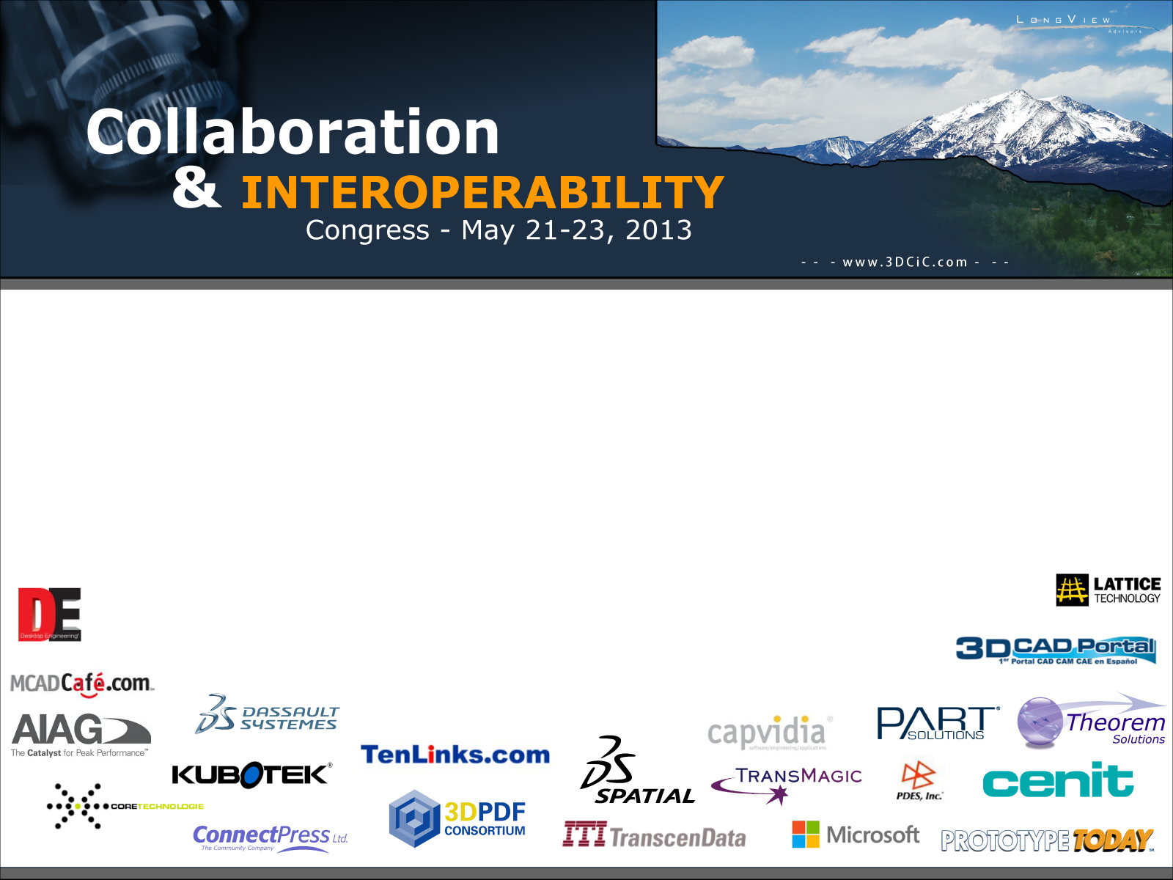

Concurrent engineering approach to design mission feasibility studies at CNES
JL. Le Gal
Plateau d’Architecture des Systèmes Orbitaux
Centre National d’Etudes Spatiales

Slide 2
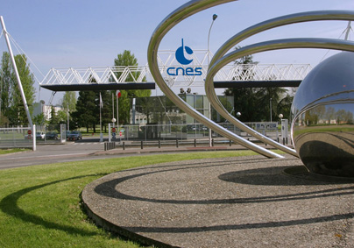
The Toulouse Space Centre
Develops
Leads
the orbital system Projects
(satellites and onboard payloads, ground segments)
satellite station acquisition
& keeping operations
technical policy
preparation of the future
and executes scientific
balloon-borne experiments
Ensures
use of data and
innovative applications

Slide 3
Content
PASO and the Concurrent Engineering Facility
Concurrent Engineering Process
  The engineering satellite model
  Description of the mission
Partners and lessons learned

Slide 4
PASO (Plateau d’Architecture des Systèmes Orbitaux)
Goal : To assess feasibility of space mission candidates
  To support programme directory for programme decision with technical and cost expertise,
  To support science team in their proposal to Calls,
  To identify technology activity or possible usage of new concepts.
Organization :
  An office with full time engineers,
  a cost estimation unit,
  a group of 60 expert engineers (in technical departments),
  A Concurrent Design Facility (CIC : Centre d’Ingénierie Concourante).
Yearly :
  ~10 – 15 studies
  ~20 – 30 fte
  ~1 M€ for contract support

Slide 5
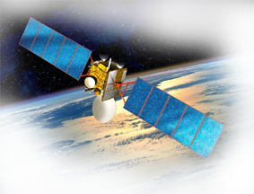



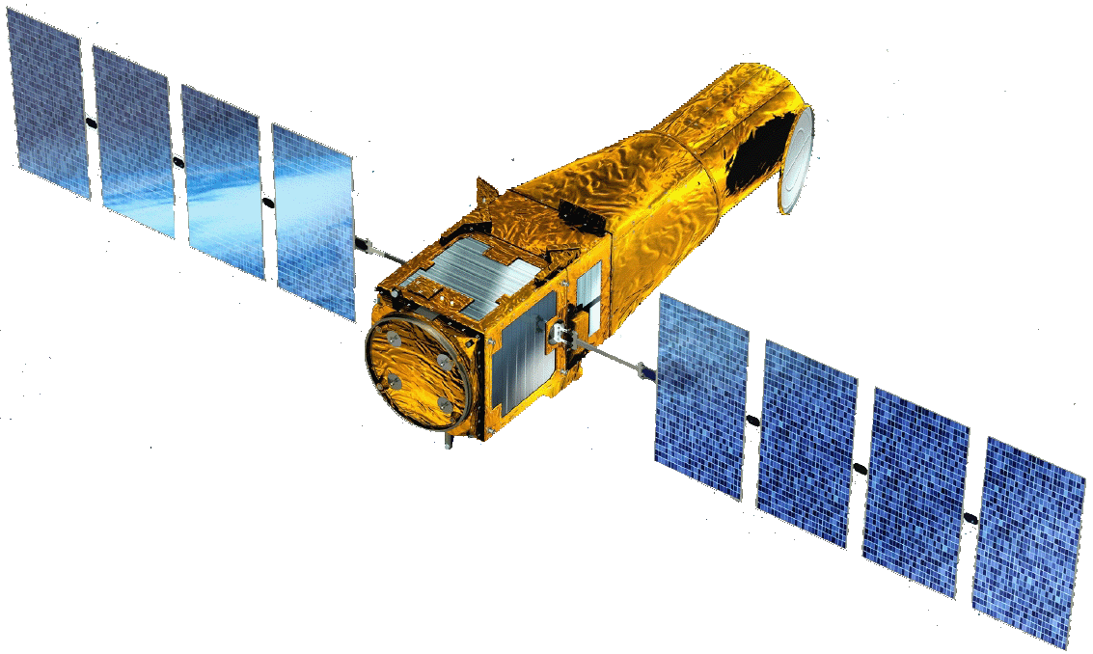

PASO studies
➔
Telecommunications
A plan of studies of new missions or new concepts in order to
  Build phase A programme decision
  Help to define CNES position on programmatic or technical aspects
Navigation
Security
Defense
Earth observation
climate
Universe
Sciences

Slide 6
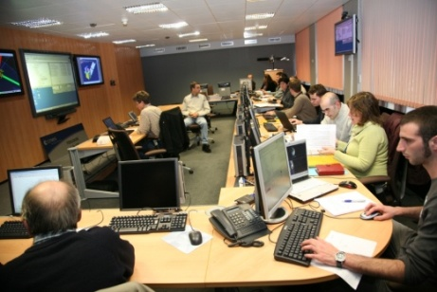

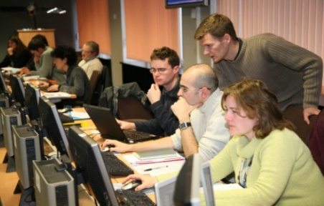
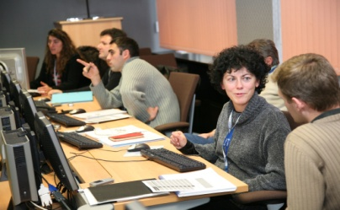
General approach for mission assessment
Mission Advisory Group (user representatives, customers…)
Phase 1
Identification of drivers
(mission, program, technical) and scenarios
Phase 2,3
Analysis, comparison of scenarios,
Optimisation and selection
Mission
Definition
Review
CNES team, partners, industry support …

Slide 7
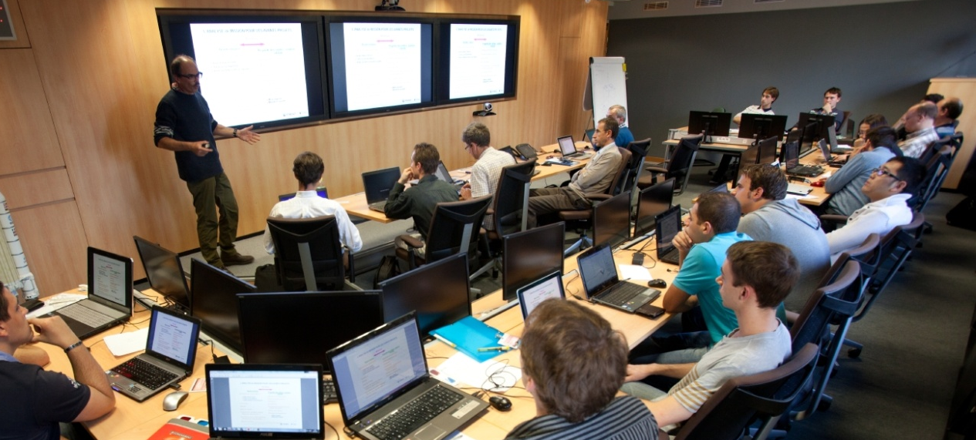
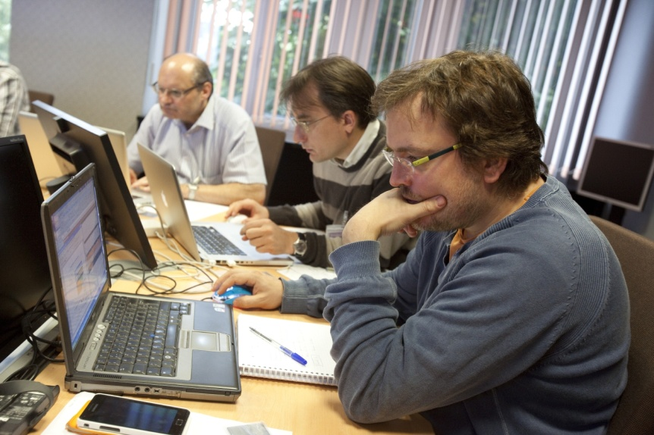
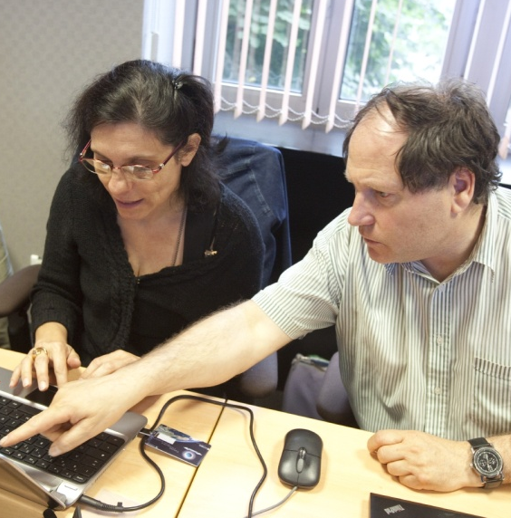
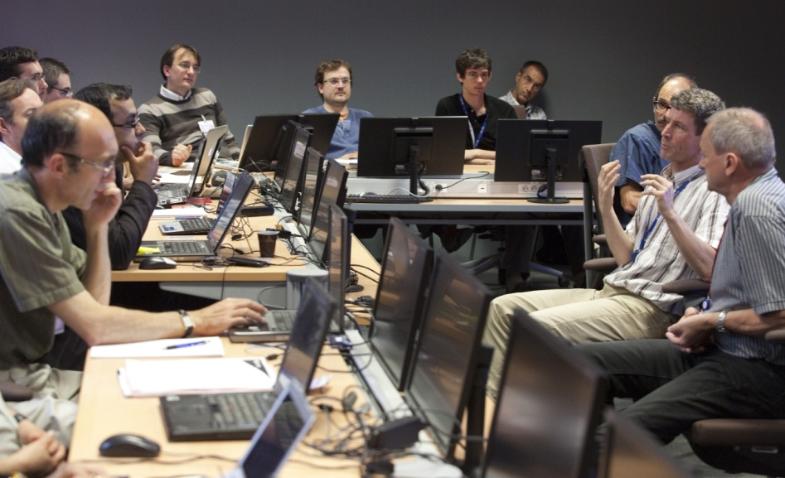
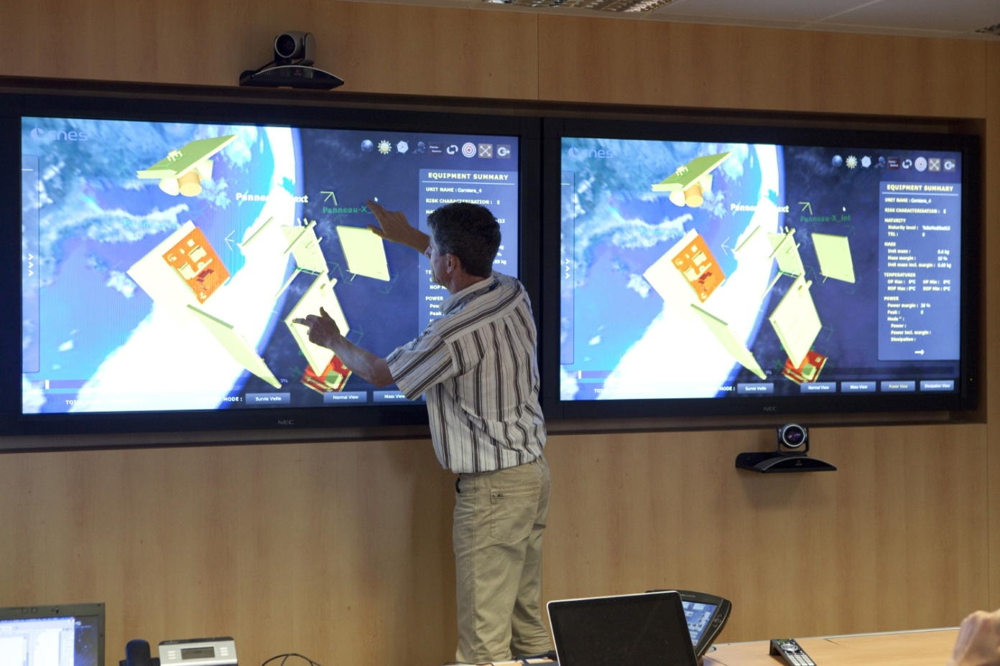
CIC (Centre d’Ingénierie Concourante )

Slide 8
CIC : Multi-touch screen
Hardware : PQ Labs TM kit
Software : SHELL-MT TM
Mapping file
keyboard/mouse actions
multi-touch interactions
Multi-touch on traditional applications
Example :
- touchDown with one finger -> left mouse-click pressed
- TouchUp with one finger -> left mouse-click released
- TouchPinch between 2-10 fingers -> left mouse-click released at the pinch + mouse roll

Slide 9
Preparation of CIC sessions
Mission Group
Client
PASO Group
Needs
Programmatics
Technics
OPTIONS
Param. 1 (Resolution)
Param. 2
(Spectral Bands)
Param. 3
…
Param. 1 (Orbit)
Param. 2
(Platform)
Param. 3
…
Param. 1 (Cooperation)
Param. 2
(Launch Date)
Conf A
Perfo ?
Cost ?
Budgets ?
Conf B
Perfo ?
Cost ?
Budgets ?
Conf C
Perfo ?
Cost ?
Budgets ?

Slide 10
Content
PASO and the Concurrent Engineering Facility
Concurrent Engineering process
  The engineering satellite model
  Description of the mission
Partners and lessons learned

Slide 11
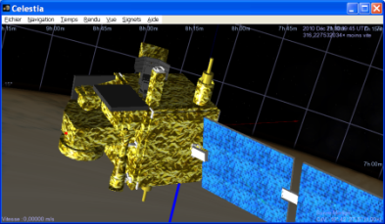
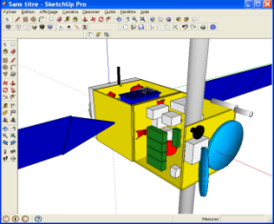
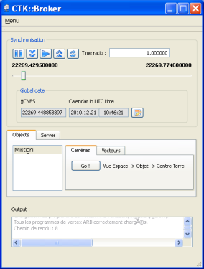
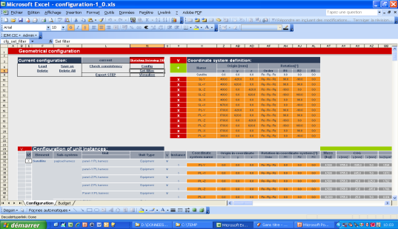
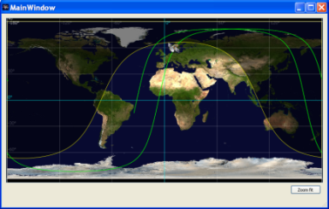
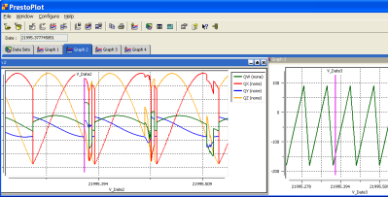
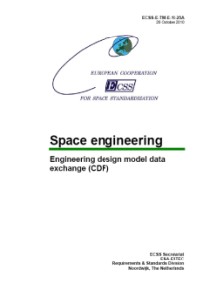
CIC Approach
Collaborative creation of a technical reference allowing establishment of satellite budgets :
2 models implemented :
  - Description of the satellite
  - Description of ephemeris of mission phases
The base consists of a set of files based on implementation of standards :
ECSS-ETM-10-25A :
Engineering design model data exchange
CIC exchange protocol

Slide 12
Content
PASO and the Concurrent Engineering Facility
Concurrent Engineering process
  The engineering satellite model
  Description of the mission
Partners and lessons learned

Slide 13
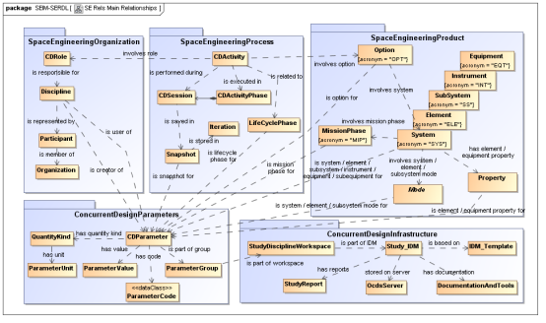
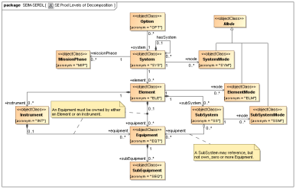

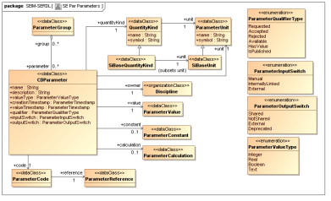
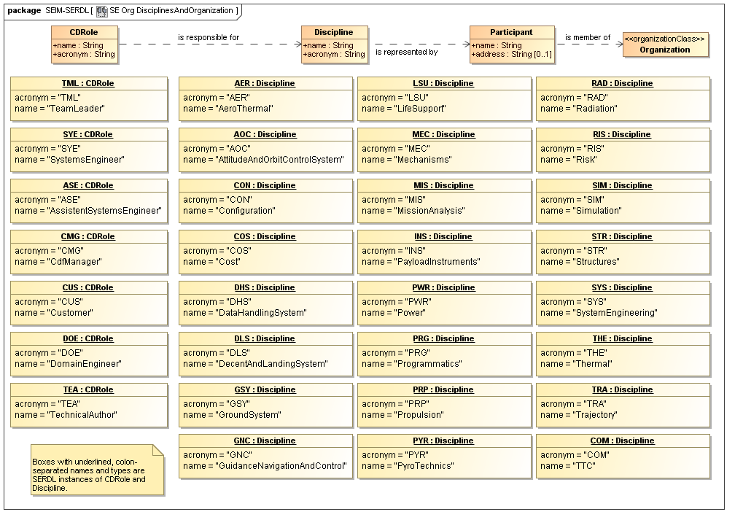
Description of the satellite based on the ECSS-ETM-10-25A standard
System Engineering
Information Model
(SEIM)
Space Engineering
Reference Data Library
(SERDL)
XML model,
Web Services…

Slide 14
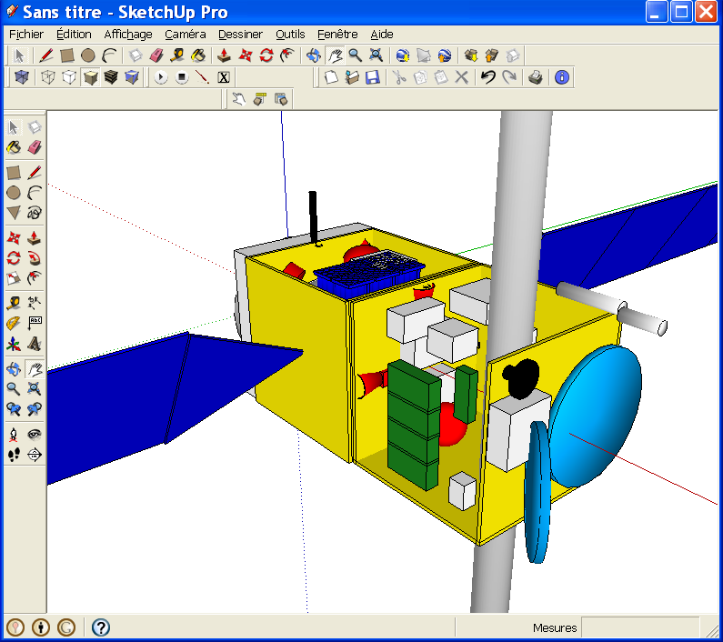
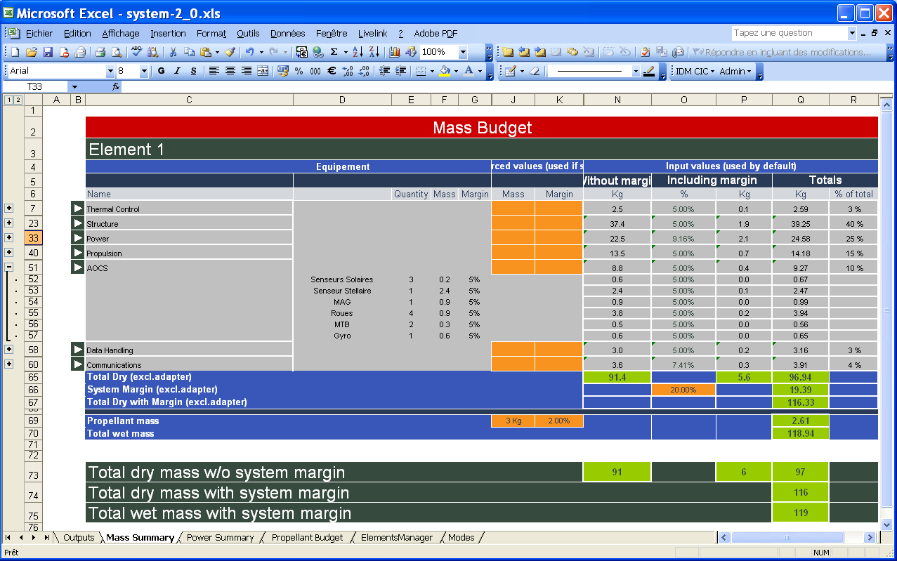
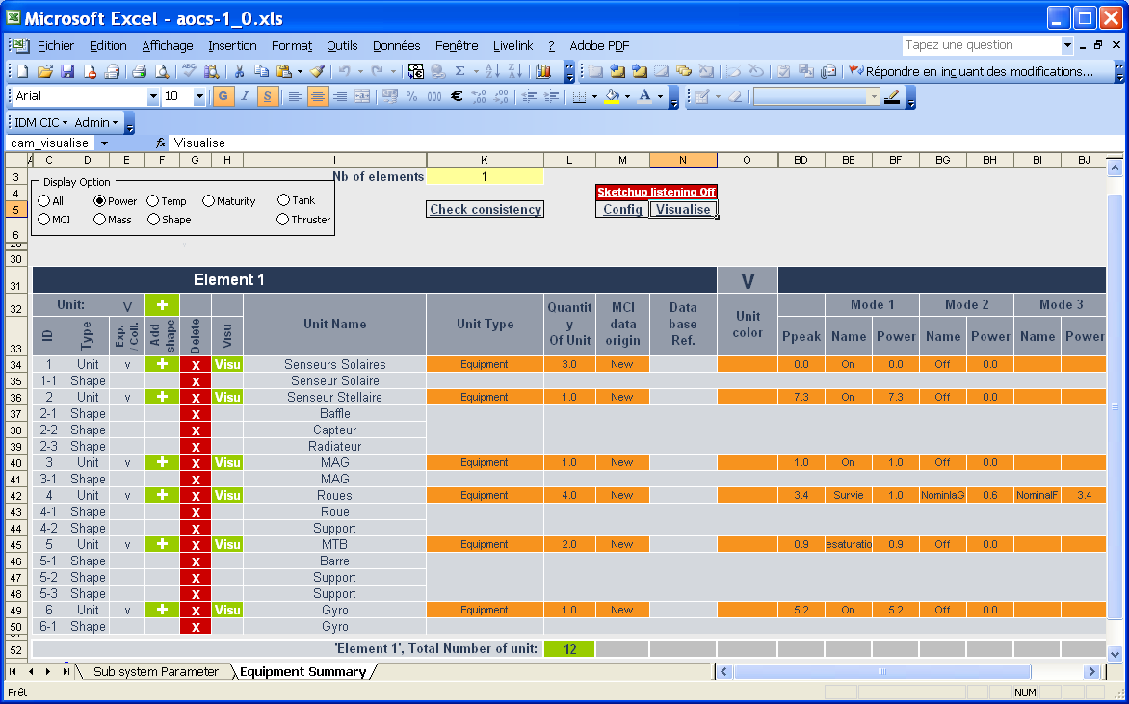
IDM-CIC : A structured and shared View of the satellite
Excel description of :
- equipments,
- sub-systems,
- payload,
- satellite,
- mission phases
to perform budgets :
- Mass Center and Inertia
- consumed power
- propellant
- …
- …

Slide 15
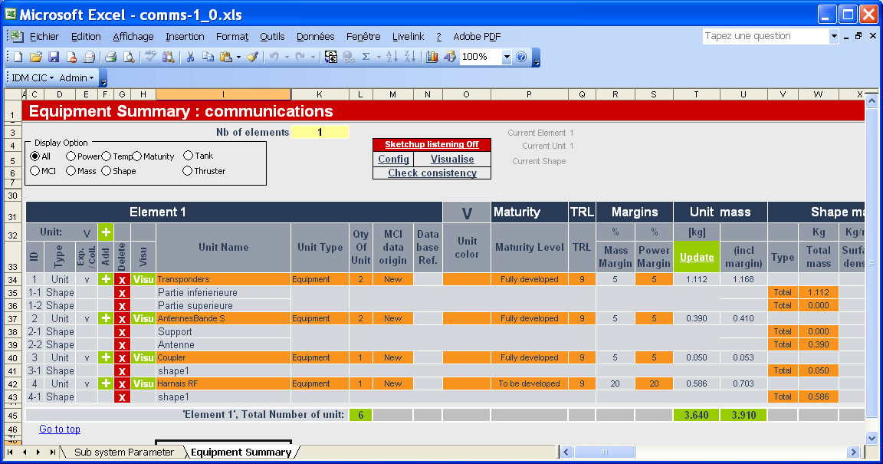
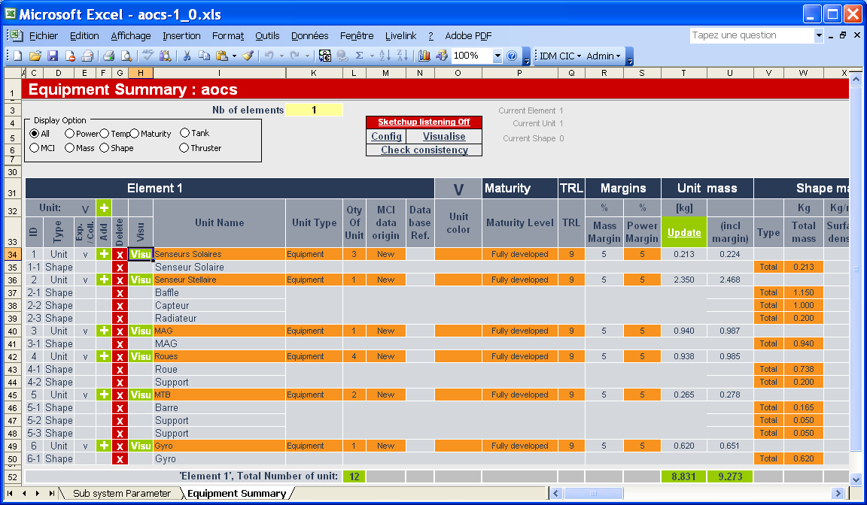
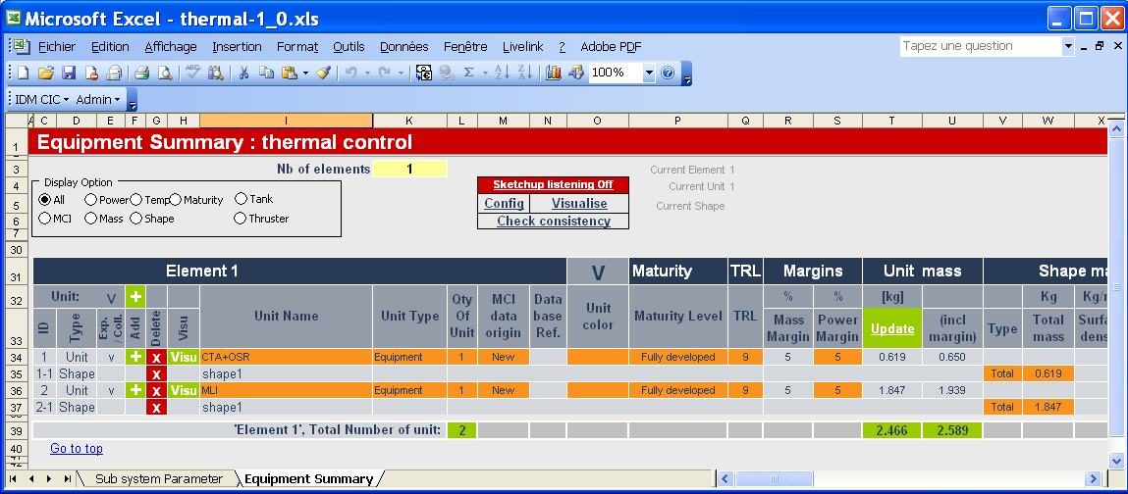
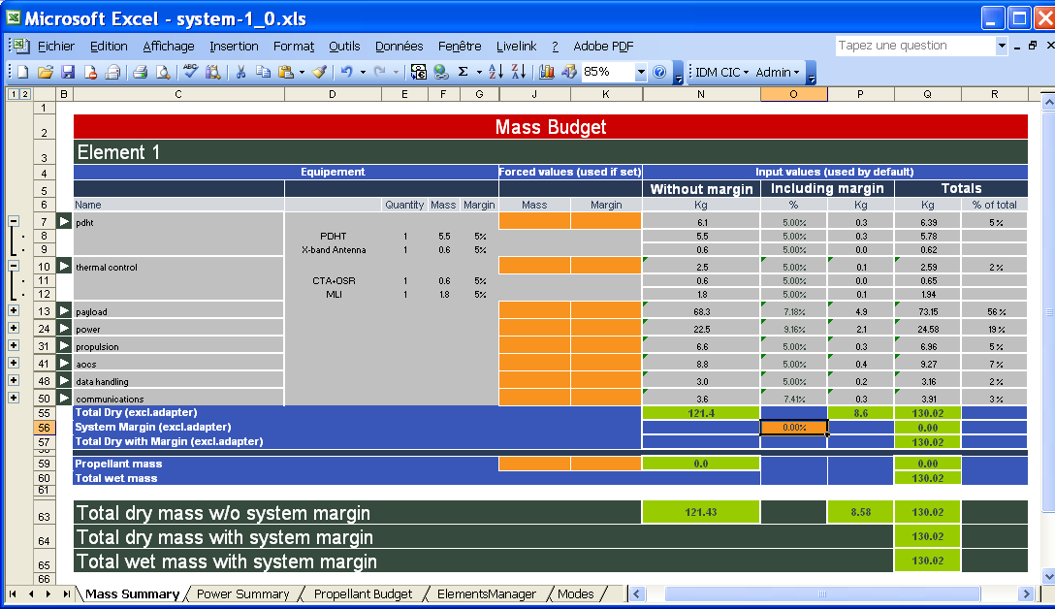
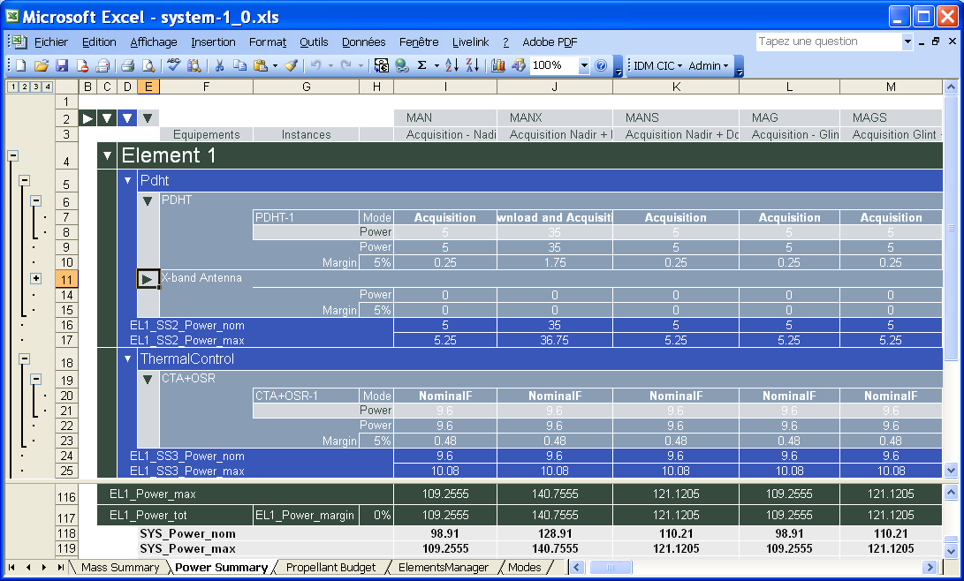
IDM-CIC approach
Data-handling
AOCS
Thermal
Data
Exchange
Payload
Configuration
System

Slide 16
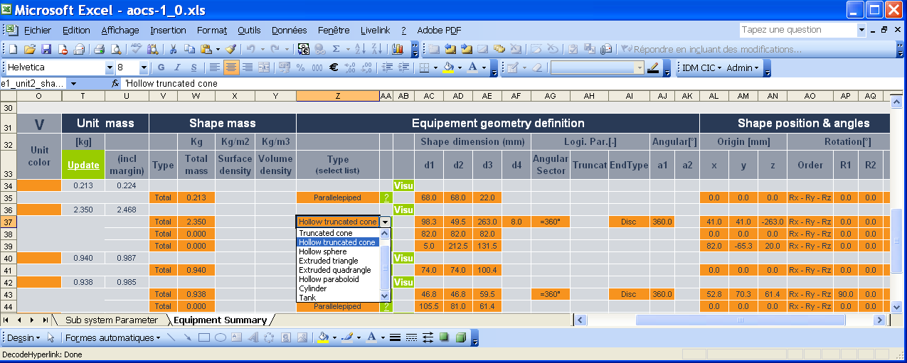
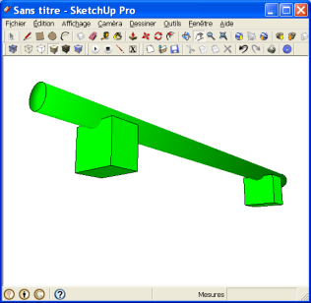
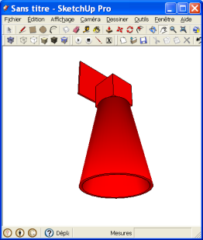
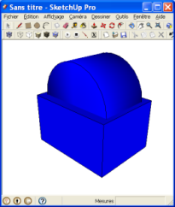
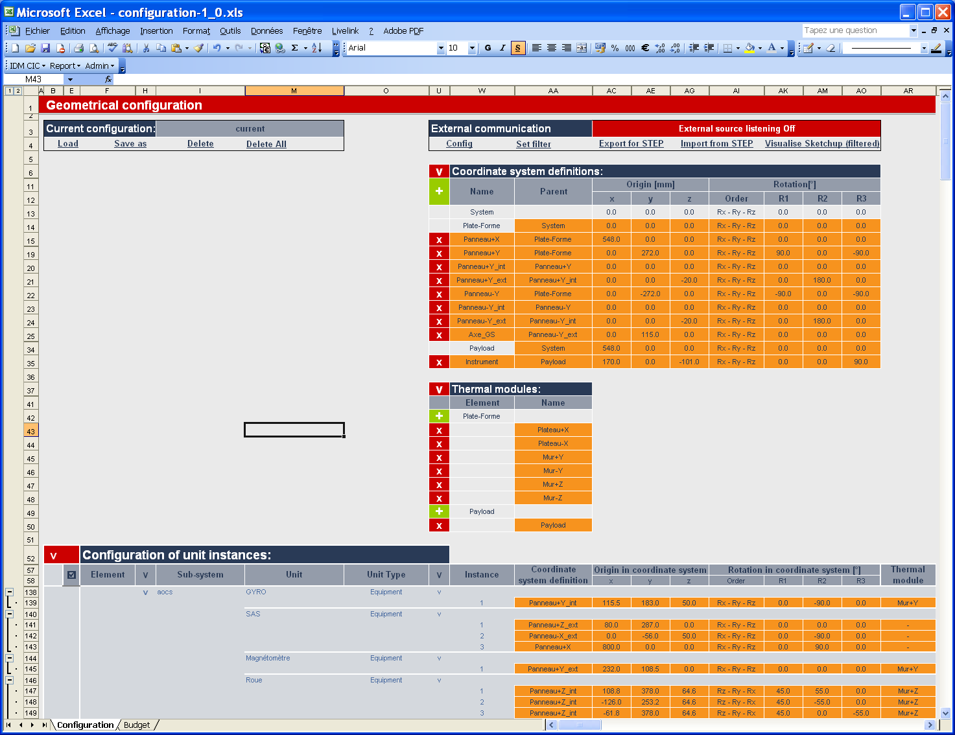
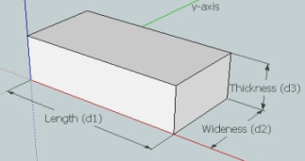
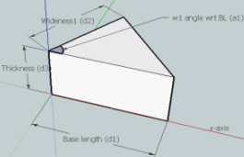
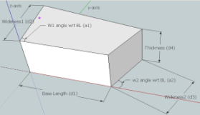
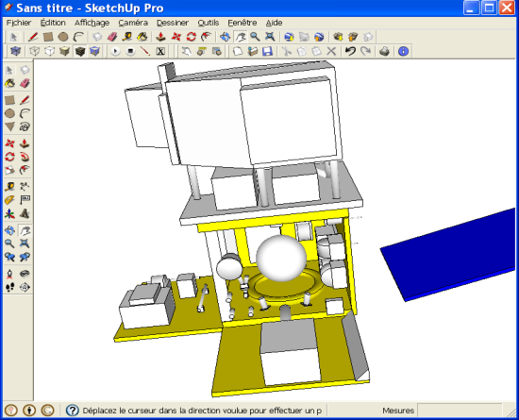
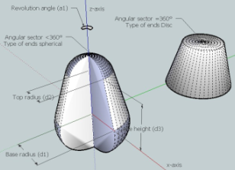
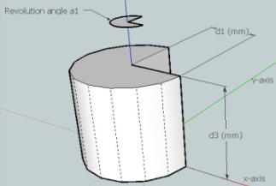
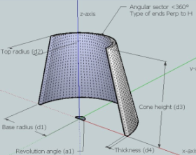
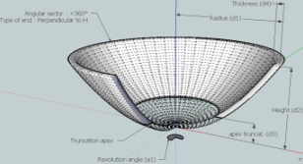
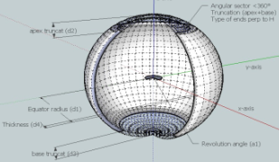
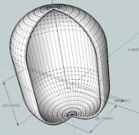
IDM-CIC : Geometric representation

Slide 17
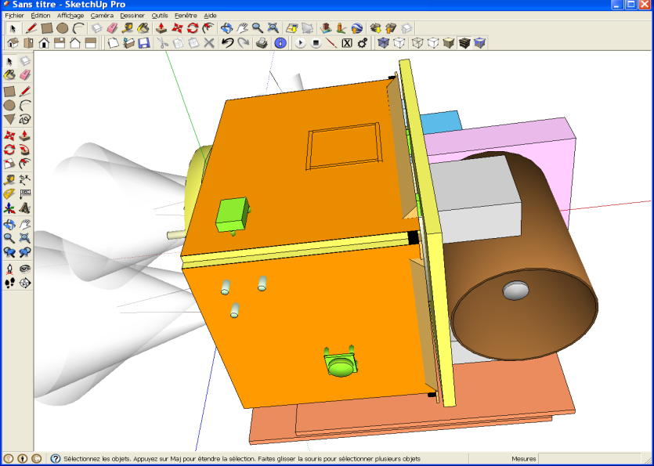
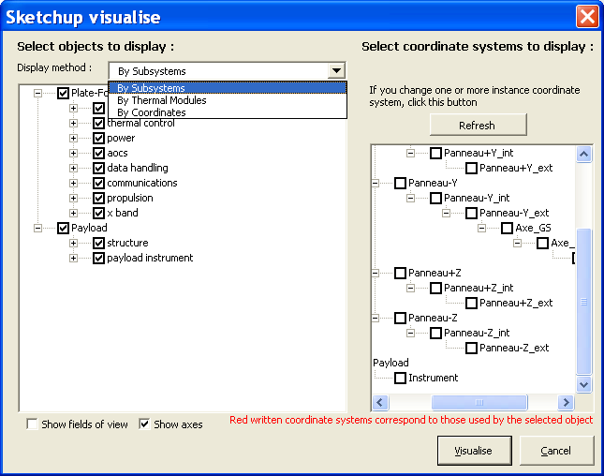
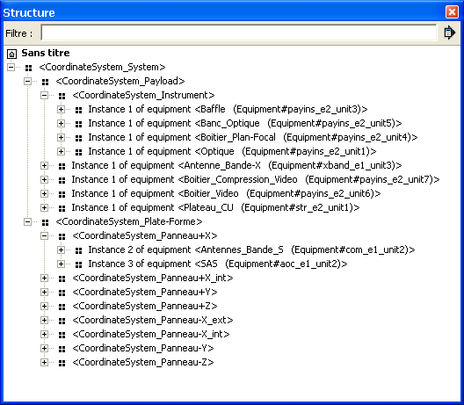
IDM-CIC / SketchUp coupling

Slide 18
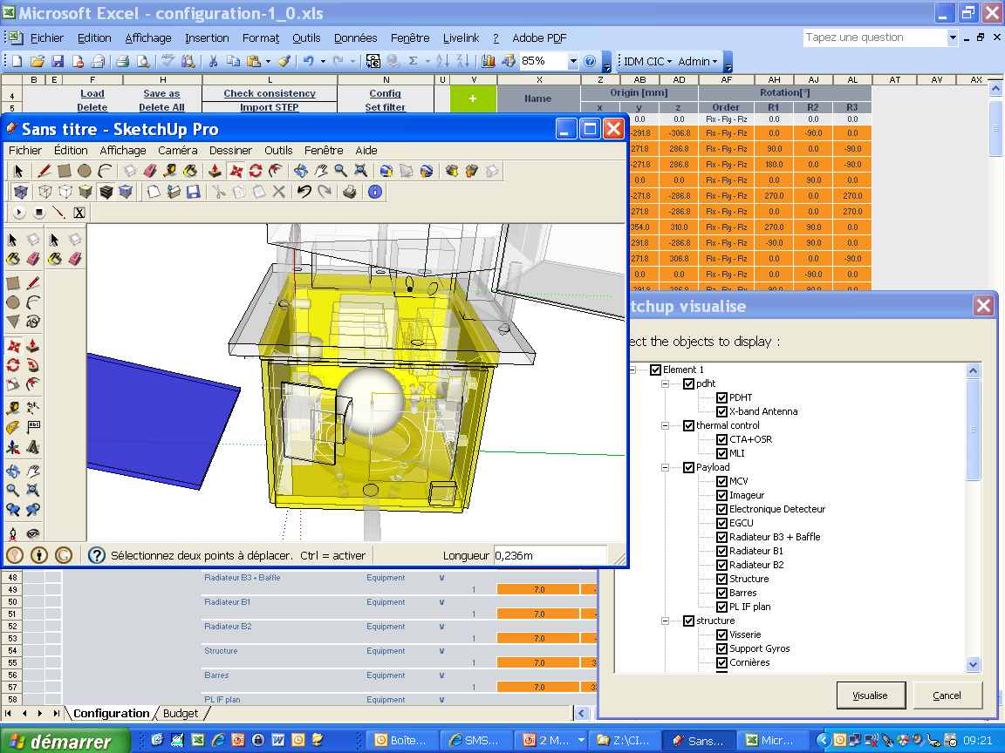


IDM-CIC : Synchronisation of IDM model with the CAD model
Export / Import
functions
IDM-CIC workbook
CATIA file
STEP file

Slide 19

IDM-CIC View

Slide 20
Content
PASO and the Concurrent Engineering Facility
Concurrent Engineering process
  The engineering satellite model
  Description of the mission
Partners and lessons learned

Slide 21


CIC exchange prototol to describe ephemeris
A solution based on CCSDS* standard
Position and velocity data :
OEM file
Attitude data :
AEM file
Complementary data :
(geometrical, thermal, electrical..)
MEM file
CIC protocol
* Consultative Committe for Space Data Systems

Slide 22




CIC files
HEADER
METADATA
DATA

Slide 23
CIC exchange protocol (extract)
Geometrical data
Communication data
Thermal data
Electrical data
AOCS data

Slide 24







VTS-CIC : Visualization of mission phases
Mistigri_OEM.txt
Mistigri_AEM.txt
Time /CMD
Time /CMD
SatelliteConsumedPower_MEM.txt
AngleSunNormSA1_MEM.txt
Time /CMD
Time /CMD
Download VTS :
http://logiciels.cnes.fr/VTS/fr/index.html

Slide 25
Content
PASO and the Concurrent Engineering Facility
Concurrent Engineering Process
  The engineering satellite model
  Description of the mission
Partners and lessons learned

Slide 26


















Partners
IDM-CIC development
Coordination of ECSS development
Advanced multi-touch solution
Industrial partners and users
VTS-CIC development
STEP development interface
Students users
Development of interface with analysis tools

Slide 27
Lessons learned
The approach is based on the establishment of :
a shared data set,
and implementation of consultation tools, easy to use, which are important to communicate.
To be effective, the working sessions must be prepared :
the working hypotheses,
and data which experts have to produce,
should be clearly defined.
The collaboration is based on the implementation of standard data and each technical expert must know exchange to contrebute to the establishment of the reference base.

Slide 28
Conclusion
CIC approach is an approach of management of project :
The technical compromises are understood and accepted by all,
Contributions of experts are valued because directly visible at the system level,
The planning of the working sessions imposes the pace of the study.
This approach implemented internally is also an effective way that enables collaboration with our partners.

Slide 29

Thank You for your attention

